Slide 1

Advance anti collision device
Authors-
Satyajeet Patnayak
Anisha Swain
Manaswini Das
Presented By - Satyajeet Patnayak
College of Engineering and Technology, Bhubaneswar
Biju Patnaik University of Technology, Odisha

Slide 2
Outlines
Introduction
Current Scenario
Evolutions of Automobiles safety system
Our System
Benefits of our system
Literature Survey
Limitations of current technology
Proposed model
Circuit Diagrams
Future Works
Conclusion
Reference

Slide 3
Introduction
Different kind of systems are present in a automobile
Transmission
Engine
Suspension
Braking System
Safety system

Slide 4
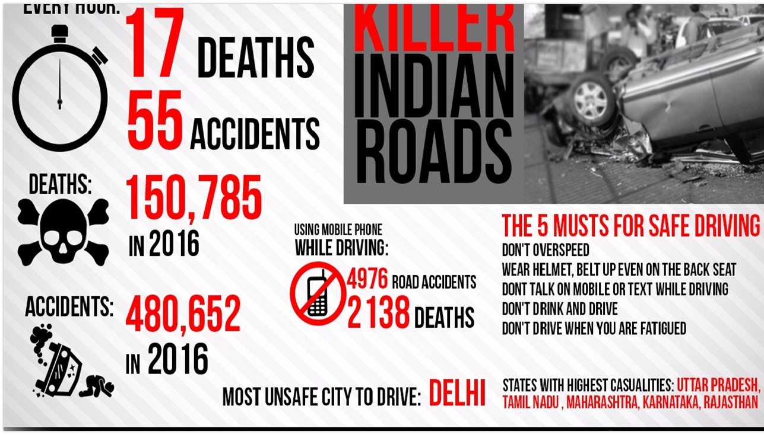
Accidents

Slide 5
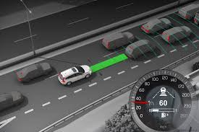
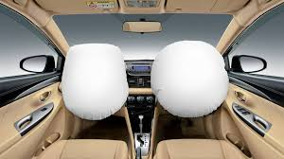
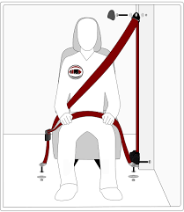
Evolution of safety systems in Automobiles
adaptive cruise control
Impact
airbags
three point seat belt
Time

Slide 6
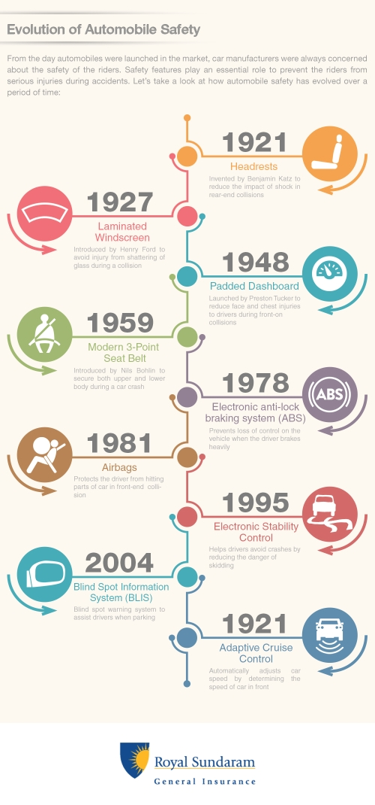
1959 - First Three Point Seatbelt System was Introduced
1978 - First Vehicle to have ABS System Installed
1981 - Vehicles came with Airbags
1992 - First Vehicle to offer Adaptive cruise control
1995 - Vehicles came Electronic Stability control

Slide 7

Literature Survey
Till now many of the devices are present in the market but the outcome is not upto that extent by which we can say that accidents have been reduced much. Some research has also been made on the area of adaptive cruise Control to develop it further by A. Vahidi. The front end collision system are been used in Vehicles from a long time and further researches are been conducted by using IR sensors to prevent front end collisions pruposed by Vinesh R.
Further researches have been conducted by S.Biswas ,for enhancing highway traffic safety by using dedicated short range communication. Still some effective way has not found to achieve higher safety figures Upto some extent, Anurag, in his paper has put some efforts to warn the drivers before collision.
Also in 802.15.4 the connectivity between two vehicles was highly depending on nature of path and most beneficial in LOS communication. On another paper by Uvaraja pruposed by Tan H.s,, the system was using RFID and FLIR cameras and was only meant to be used in Railway and not on roads.

Slide 8
Limitations of current technology
Only front end collision avoiding system are present
Not present standard safety future in every vehicles
Out of hands from the middles segment cars
Cruise controls and Collision warning system are only present in high end vehicles.

Slide 9
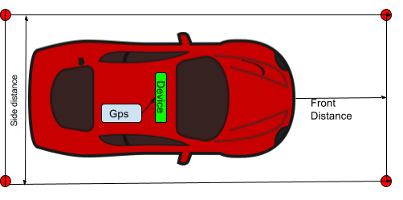
Our System
Vehicle
Gps Module
Zigbee
ABS ECU
ABS Sensors
Brakes

Slide 10
Proposed Model
Finding safety zones of vehicle
Variation in safety zones of vehicle
calculation of safety zone with ref. to speed
Finding safety zones of vehicle
Finding safety zones of vehicle
Finding safety zones of vehicle
Finding safety zones of vehicle

Slide 11
Components Required
Gps module
Zigbee
Voltage regulator
Arduino Uno

Slide 12

Calculation of Safety Co-ordinates
If we take :-
V = velocity of vehicle
$μ$ = Coefficient of friction (0.60 assumed)
g = Acceleration due to gravity (9.8 m/s assumed)
d = stopping distance
So,
$d=\frac{v^{2}}{2μg}$

Slide 13
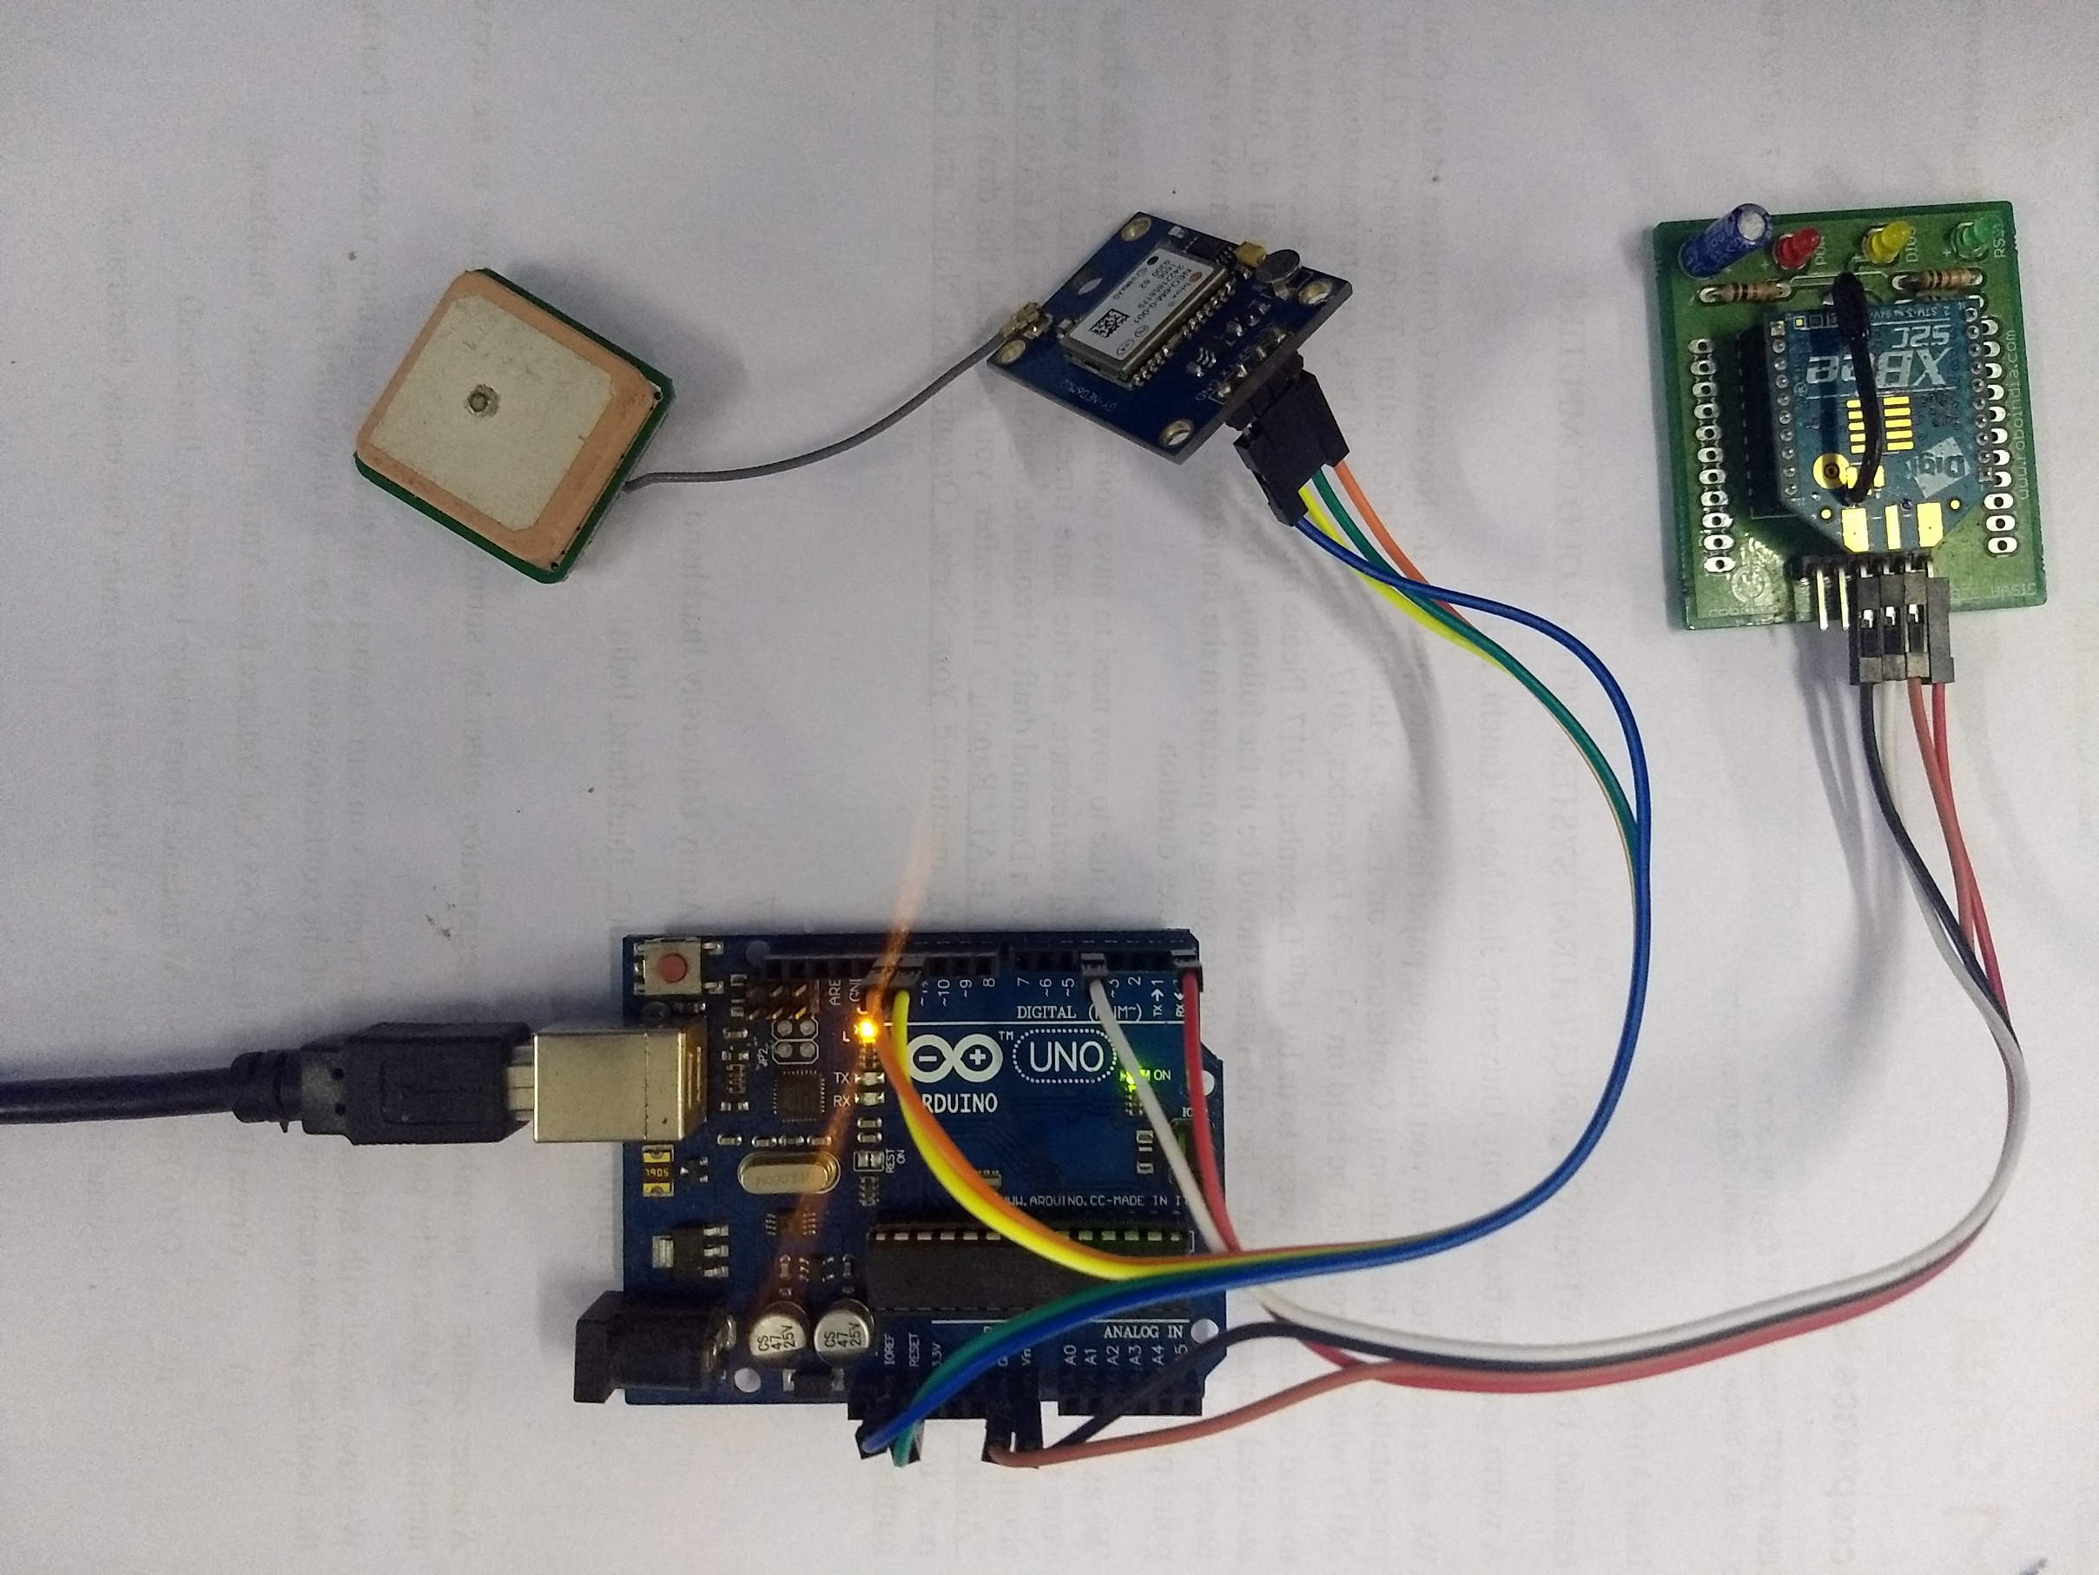
Real Life implementation

Slide 14
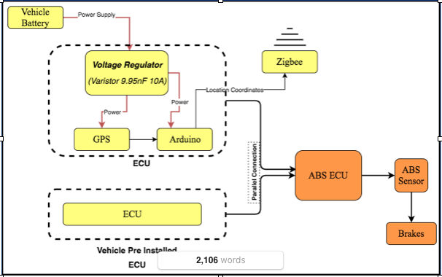
Circuit Diagram

Slide 15
Benefit of Our System
Reduces chances of accidents up to 90%
Easy installation
Affordable
Environment Friendly
Easy Manufacturing
Low maintenance cost

Slide 16
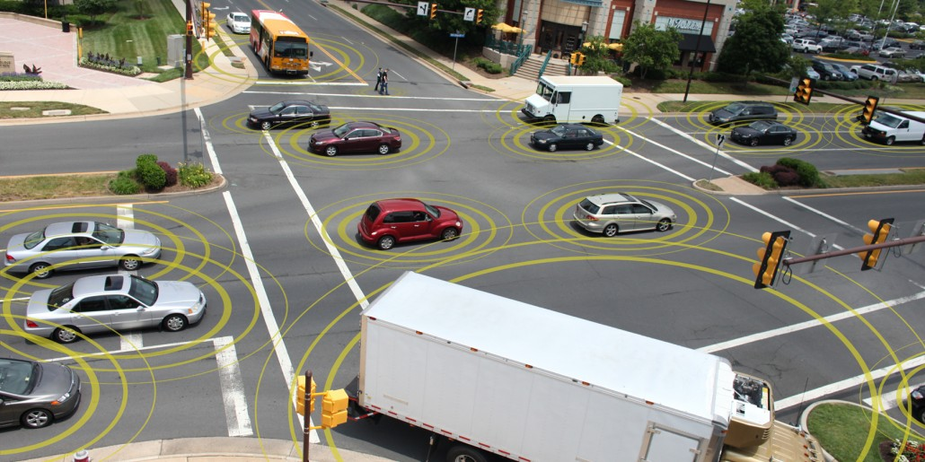
Conclusion
We presented an overview of collision avoiding systems by using ZigBee and GPS. The system was capable of detecting the vehicle without any direct line of sight and applying the brakes using our ECU at sufficient distance. We believe that our system will improve the safety of the vehicles and further decrease the chance of collisions up to a great extent. We tried to make our system as robust as possible so that it can be used in any type of vehicles without any further problems.

Slide 17
Future Works
As of now we have only made the device to be work on ABS systems because that has an ECU in it. Our Future works are to be used the system in drum Brakes also because most of the old vehicles running in our countries are still using drum brakes in it.
The device will be further enhanced by using machine learning as the device will automatically understand the behaviour of the driver’s driving condition and the driver’s reaction time.

Slide 18
References
A. Vahidi and A. Eskandarian, (Sept. 2003) "Research advances in intelligent collision avoidance and adaptive cruise control," in IEEE Transactions on Intelligent Transportation Systems, vol. 4, no. 3, pp. 143-153.
Vignesh, R. (May 2017) “Collision Avoidance System In Vehicles”International Journal of Advanced Research Methodology in Engineering & Technology, ISSN 2456 6446 Volume 1,Issue 3
Araki, H., Yamada, K., Hiroshima, Y., & Ito, T. (1996, September). Development of rear-end collision avoidance system. In Intelligent Vehicles Symposium, 1996., Proceedings of the 1996 IEEE (pp. 224-229).
Miller, R., & Huang, Q. (2002). An adaptive peer-to-peer collision warning system. In Vehicular technology conference, 2002. VTC Spring 2002. IEEE 55th (Vol. 1, pp. 317-321). IEEE.

Slide 19
Tatchikou, R., Biswas, S., & Dion, F. (2005, December). Cooperative vehicle collision avoidance using inter-vehicle packet forwarding. In Global Telecommunications Conference, 2005. GLOBECOM'05. IEEE (Vol. 5, pp. 5-pp).
Anurag, D., Ghosh, S., & Bandyopadhyay, S. (2008, October). GPS based vehicular collision warning system using IEEE 802.15. 4 MAC/PHY standard. 8th International Conference on ITS Telecommunications, 2008: 154-159
Lou F., What’s the Difference Between IEEE 802.15.4 and Zigbee Wireless? Electronic Design: 2013
Uvaraja, S. (2012). Advanced Pre-Warning System (Railways). International Journal of Engineering and Technology, 4(2): 213.
Tan, H. S., & Huang, J. (2006). DGPS-based vehicle-to-vehicle cooperative collision warning: Engineering feasibility viewpoints. IEEE Transactions on Intelligent Transportation Systems, 7(4): 415-428.

Slide 20
Thank You
Presented By - Satyajeet Patnayak

